Slide 1


Windows OS Malware Prediction Using Machine Learning
Project Group 32
Brandon Gray, William Holdren, Md Sanzid Bin Hossain, Nabila Shahnaz Khan
March 25, 2021

Slide 2
Outline
Dataset Features
Data Preprocessing
Preliminary Model Analysis
Potential Issues
Future Work
References

Slide 3
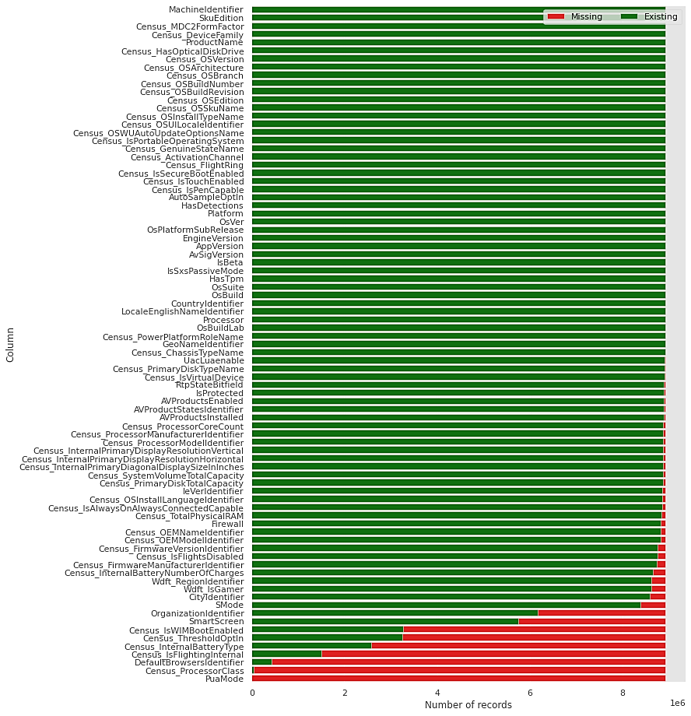
Dataset Features
(Missing Values)
Among 83 features, 44 features have missing values
This plot shows the feature-wise distribution of missing values

Slide 4
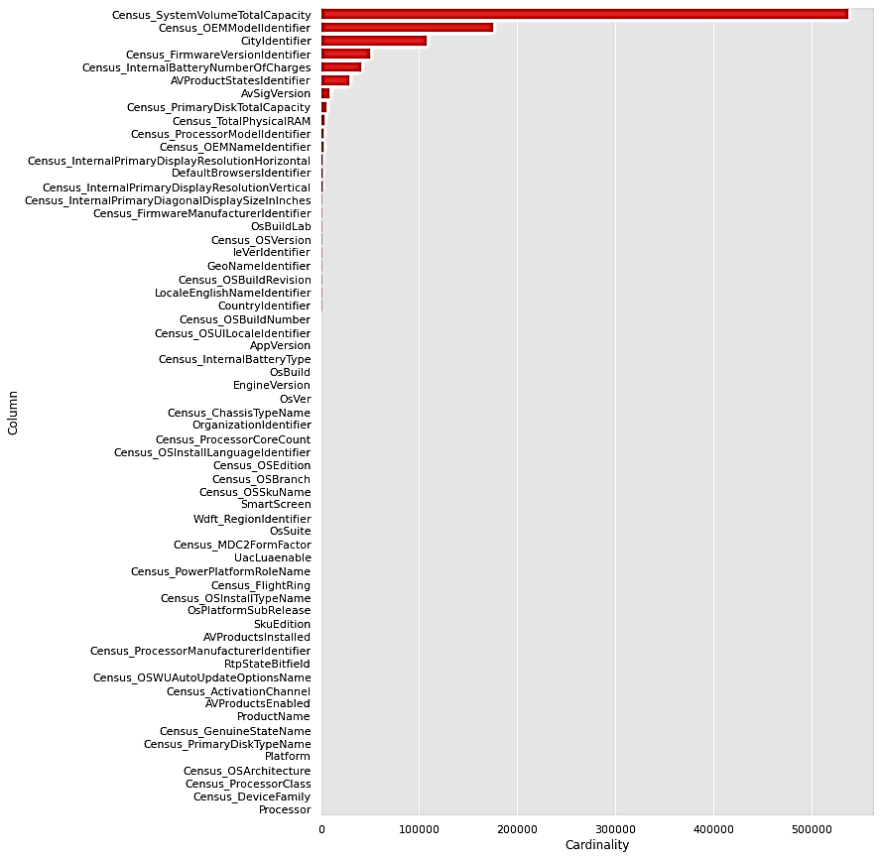
Dataset Features
(Cardinality)
High cardinality categorical features can be visualized
Provides information on which features to consider dropping from the dataset for training

Slide 5
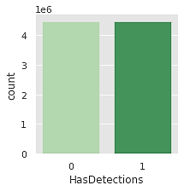
Dataset Features
(Balance of Classes)
Balance of Classes for the Two Class labels (HasDetections = 0 and HasDetections = 1)
Training data set is quite balanced
Has almost equal distribution of labels.

Slide 6
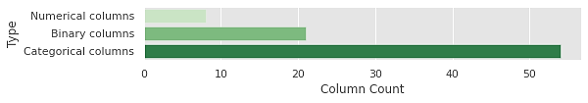
Dataset Features
(Types of Features)
Numerical | 8
Binary | 21
Categorical | 54
Total | 83
Three types of features:
Categorical Features
Binary Features
Numerical Features

Slide 7
Data Preprocessing
About the data
83 features, mostly nominal, some ratio
About 9 million data objects
All features were converted to numerical values for comparison and evaluation
Each feature was evaluated individually for possible correlation
High cardinality features (unique values greater than 500) were automatically dropped-10 features
Features with more than 40 % of the values missing were also dropped-6 features
Remaining missing values were handled by replacement with -1, making them a separate category for each feature

Slide 8
Data Preprocessing
Importances of all the features were compared using methods like Logistic Regression, Decision Tree, Random Forest, XGBM and LGBM
Using Logistic Regression model, no clear pattern of important and unimportant features could be identified; positive scores indicate a feature that predicts class 1, whereas the negative scores indicate a feature that predicts class 0
After performing intersection on lists of important features generated by the Decision Tree, Random Forest, XGBM, and LGBM models, we got a list of 42 commonly important features

Slide 9
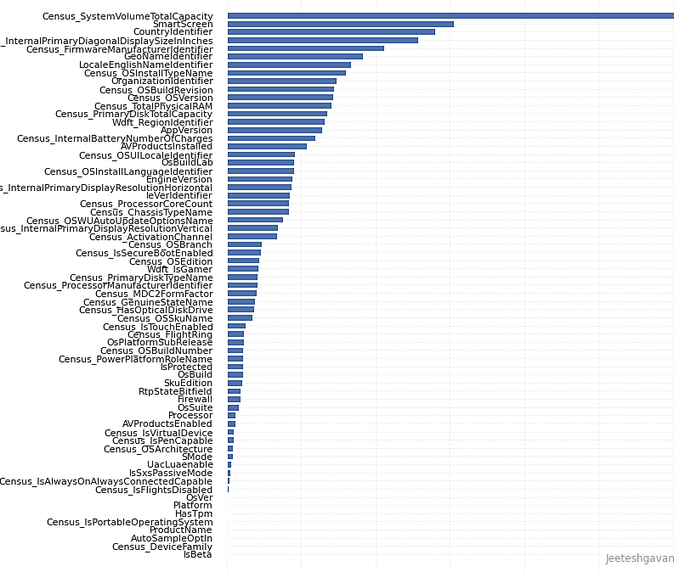
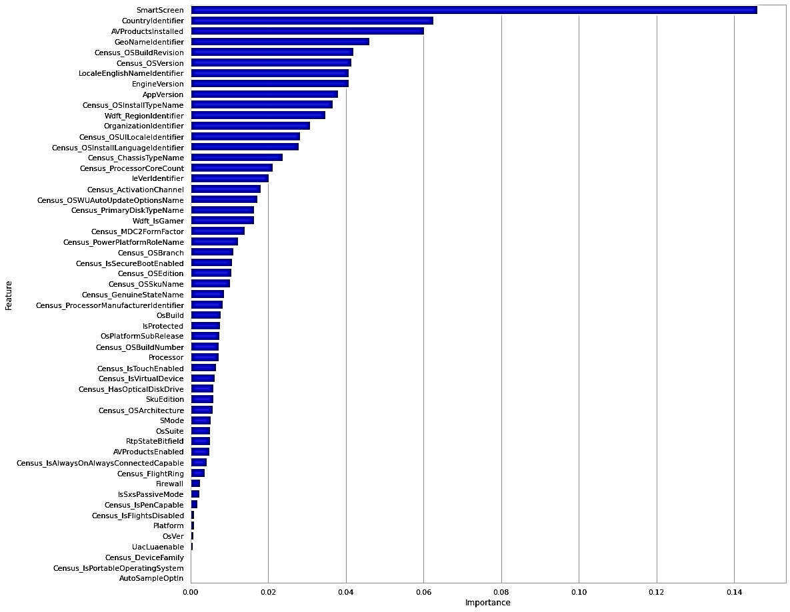
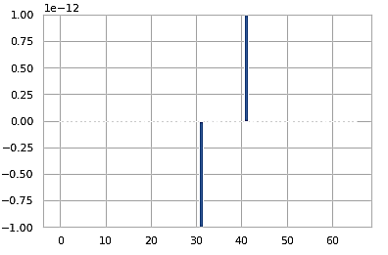
Feature Importance
Based on the Decision Tree Model
Based on the Logistic Regression Model
Based on the Random Forest Model

Slide 10
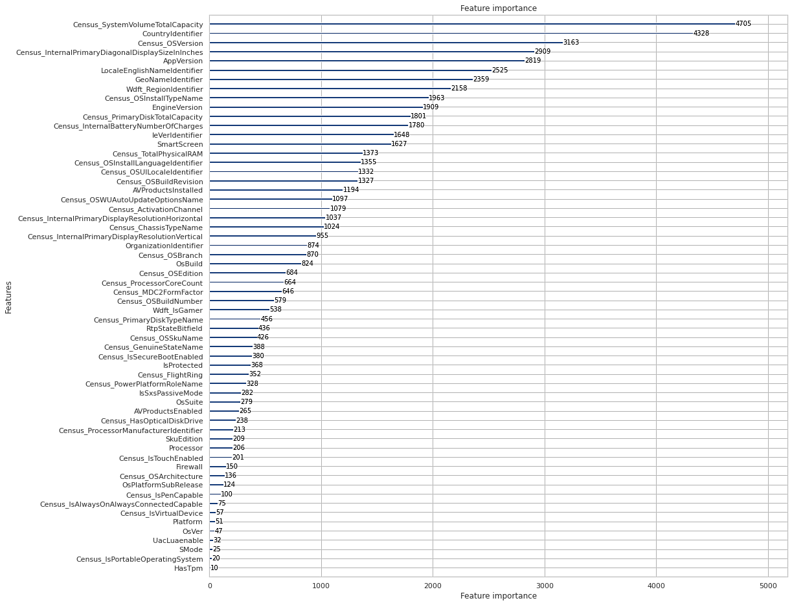
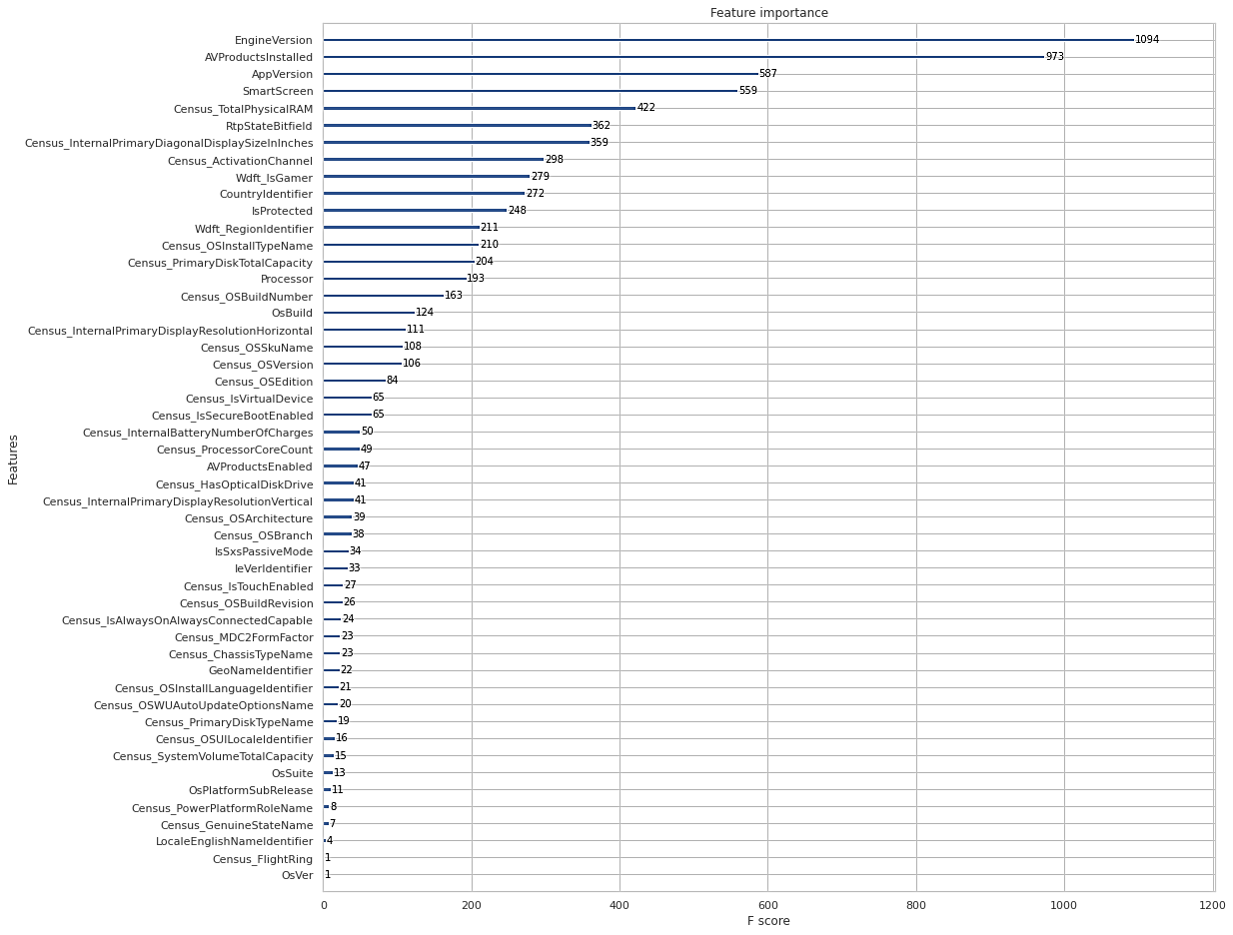
Feature Importance
Based on the LGBM Model
Based on the XGBM Model

Slide 11
Preliminary Model Analysis
Gradient Boost and Random Forest ended up giving the best accuracies so far
Due to the training time requirements of SVM and KNN with high dimensional data, they had to be tested using significantly smaller samples
1/20 for KNN in addition to applying feature scaling and principal component analysis
1/10000 for SVM
Random Forest can give drastically different accuracies depending on number of trees, max depth, and minimum samples per leaf node

Slide 12
Preliminary Accuracy Comparison
Algorithm | Accuracy | Precision | Recall | F1 Score
Random Forest | 0.65 | 0.65 | 0.65 | 0.65
SVM (1/10000 data) | 0.53 | 0.53 | 0.53 | 0.51
KNN (1/20 data) | 0.61 | 0.61 | 0.61 | 0.60
(Light) Gradient Boosting | 0.68 | 0.68 | 0.68 | 0.68

Slide 13
Potential Issues
Size of training data is very large, making training and optimization a time consuming task
This might be mitigated by taking a subset of the data (sampling)
Balancing accuracy loss against decreased training time may be required
SVM and KNN are not very suitable with this dataset due to the relatively low preliminary accuracy and high train times
They may need to be excluded from the final model
May have to modify the initial plan to build a super learner

Slide 14
Future Work
Begin refining models and optimizing the parameters
Consider additional tweaks to data preprocessing that may benefit the models as training and testing progresses
Discarding features having low importance and testing impact on model accuracies
Possibly explore a few other models for classification

Slide 15
References
Guidance was taken from Kaggle: https://www.kaggle.com/chandrimad31/malware-prediction-using-dask-for-handling-bigdata

